Slide 1
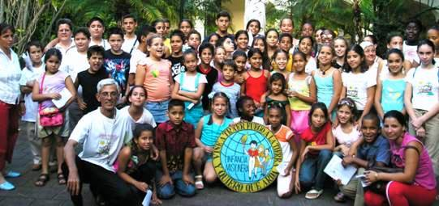
In Cuba
Notes:
Photo from the Facebook page of the Infancia y Adolescencia Misionera de Cuba

Slide 2
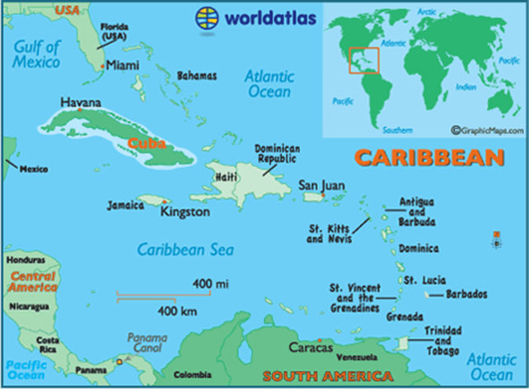
Many people who live in Cuba call themselves Christian, but few practice any faith at all. After the 1959 revolution that brought the current communist government to power, the country was declared officially atheistic. This designation was dropped in 1992 and the rules against practicing ones’ religion were relaxed.
However, after decades of persecution of the Church under communist rule, many Cuban children have never seen their parents, or in some cases even grandparents, practice the Catholic faith that was once an integral part of Cuban society.

Slide 3
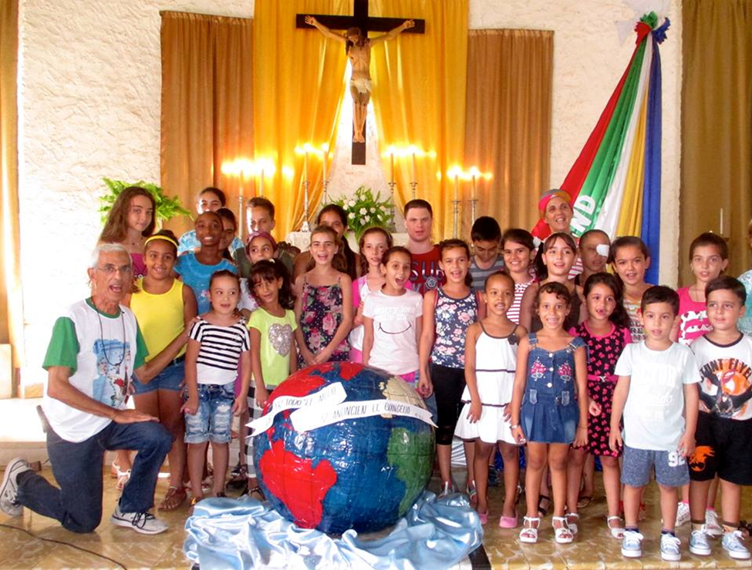
As the rules against the open practice of religion in Cuba were relaxed in recent years, Enrique Cabreras learned about the Missionary Childhood Association (MCA) and decided to start it in the Diocese of Camaguey as a way to evangelize families.
MCA is now present in most Cuban dioceses.
Cuba MCA World Mission Sunday 2016 celebration
Notes:
Photo from Facebook page of Infancia y Adolescencia Misionera de Cuba

Slide 4
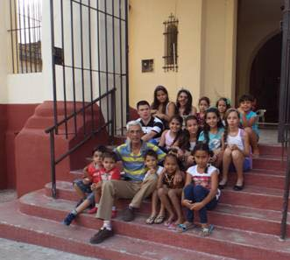
During Lent 2017, MCA members in Cuba gathered to pray and to learn about Jesus
Archdiocese of Camaguey, Cuba
Notes:
Photos from Facebook page of Infancia y Adolescencia Misionera de Cuba

Slide 5
How baseball brings the Gospel to the neighborhoods of Cuba

Slide 6
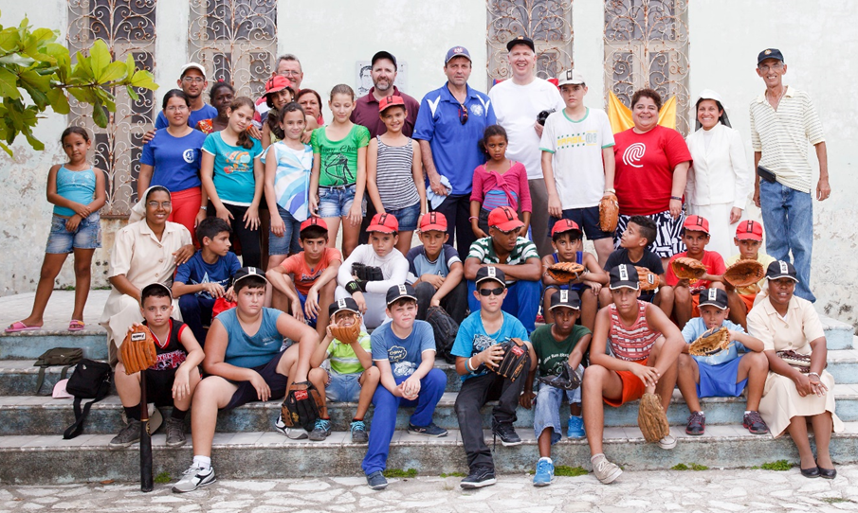
In May 2016, a group of MCA representatives and baseball coaches traveled from the U.S. to Cuba to offer some lessons in sport – and in faith

Slide 7
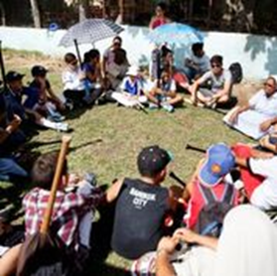
On the baseball field, Americans and Cubans prayed together . . .

Slide 8
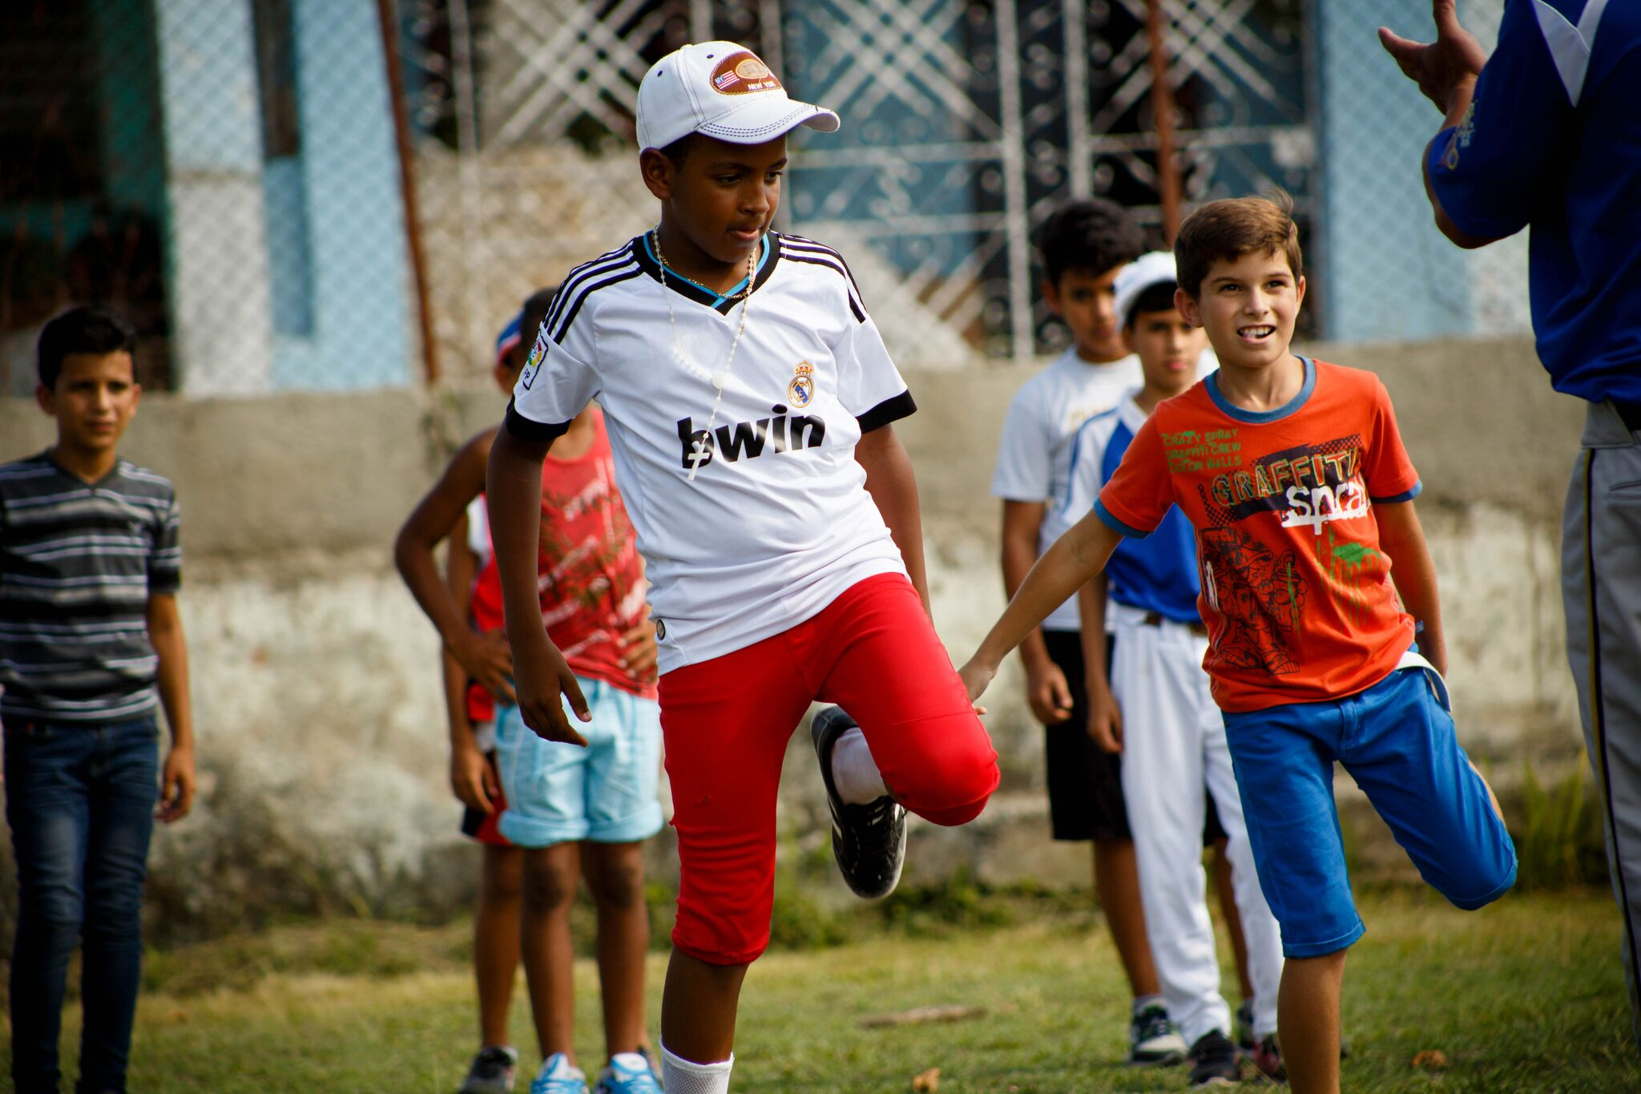
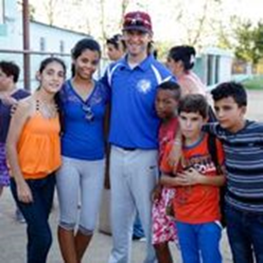
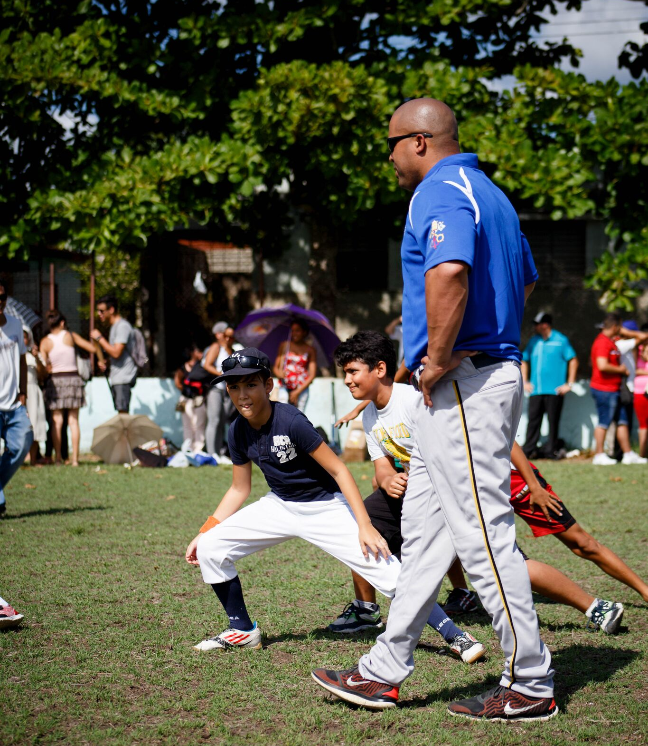
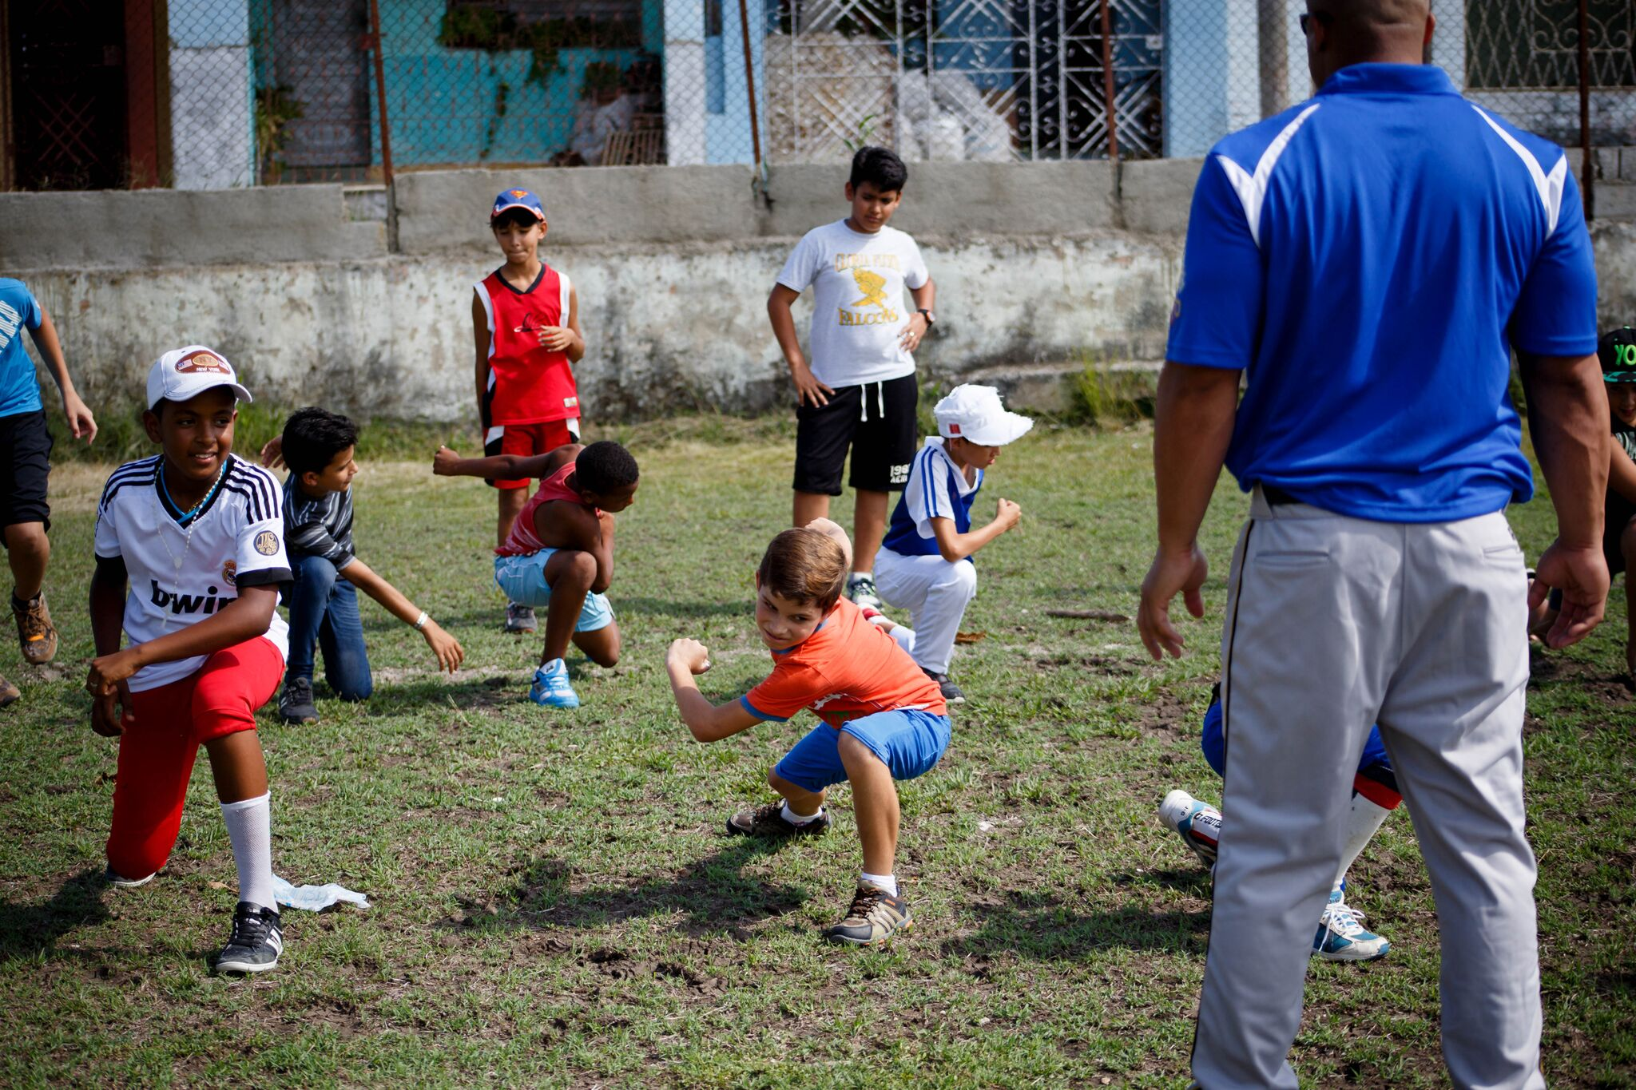
and played together

Slide 10
The hit of the day!

Slide 11
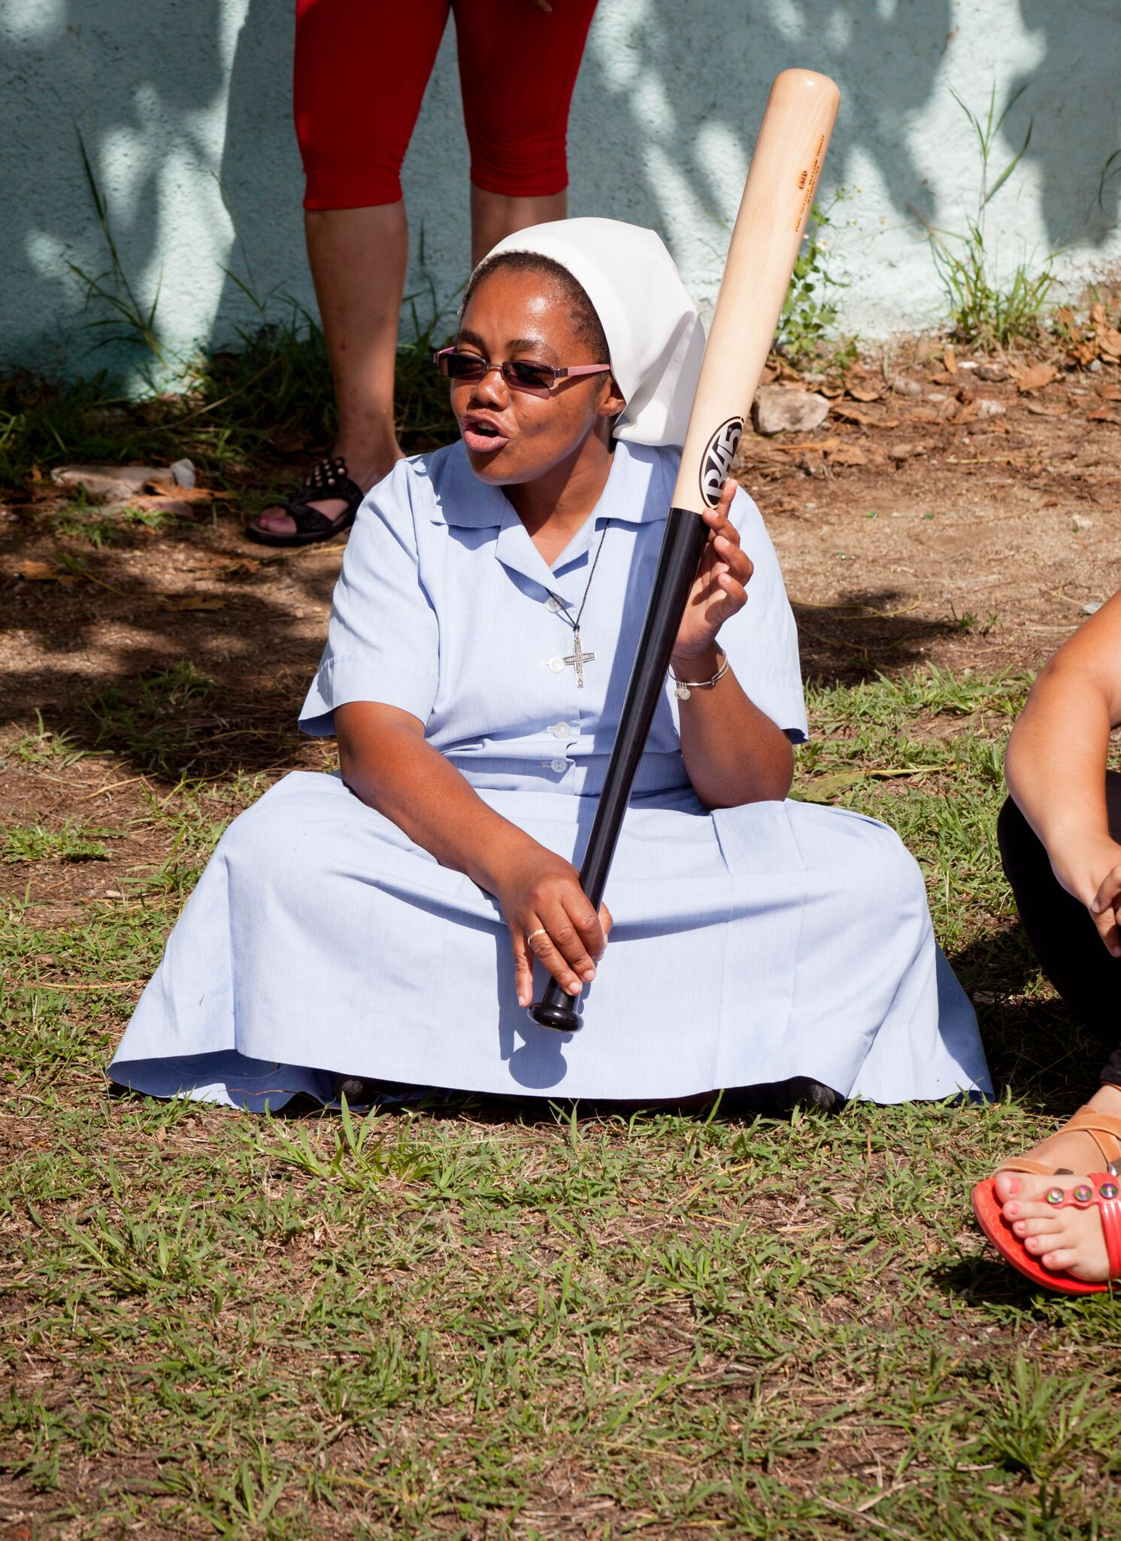
Most families in Cuba cannot afford to buy sports equipment for their children. The MCA group brought donated bats and gloves.

Slide 12
The Story of the Extra Bat
After a long day of baseball under the late May sun in Santa Clara, Cuba, the visitors from the U.S. were surprised to find an unpainted, dented, wooden baseball bat among the shiny new blue and black ones they had brought. Baseball bats are hard to come by in Cuba; they cost six Cuban pesos, and most people earn about 19 pesos a month.

Slide 13
The mismatched bat belonged to a boy named Andy, who decided that like the biblical widow, he wanted to contribute his mite.
Andy, about 11, volunteers with the Missionary Childhood Association in Cuba and had just attended the baseball camp hosted by a team of professional baseball coaches and Catholic leaders organized by the Pontifical Mission Societies in the United States.
When Andy and his friends are not playing baseball or going to school, they are going door to door talking with people about Jesus and evangelizing the two generations of Cubans that were raised without religion under the communist regime.

Slide 14
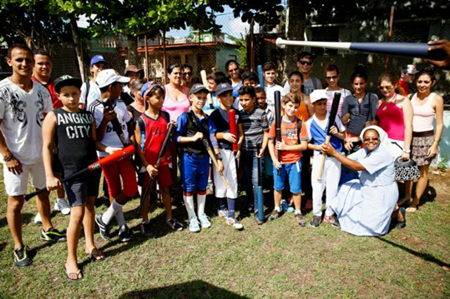
After the baseball clinic, Sister Bernadina, MCA Coordinator in the Diocese of Santa Clara, gathered the children for prayer and promised that she would return to the field the following week
Notes:
Pilot photo/Gregory L. Tracy

Slide 15
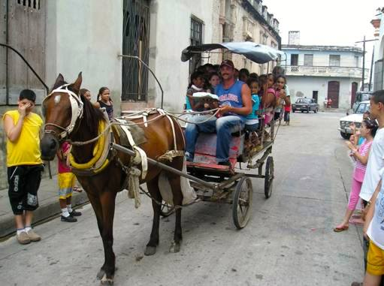
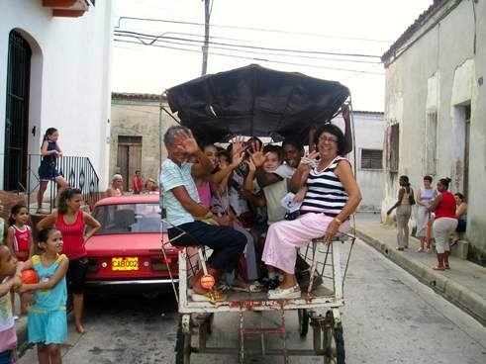
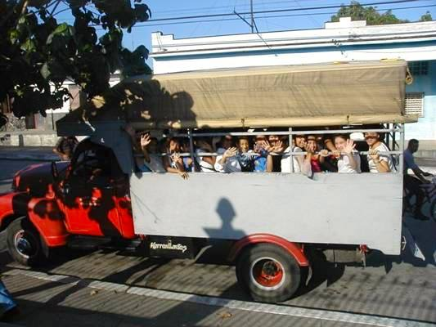
Missionary Children travel to MCA Congress in Cuba

Slide 16
August 2016 MCA Congress in Cuba
Notes:
About 300 Missionary Children from around the country attended. Many had never been outside their small towns, and traveled for hours in all sorts of vehicles, including horse-drawn carriages.

Slide 17
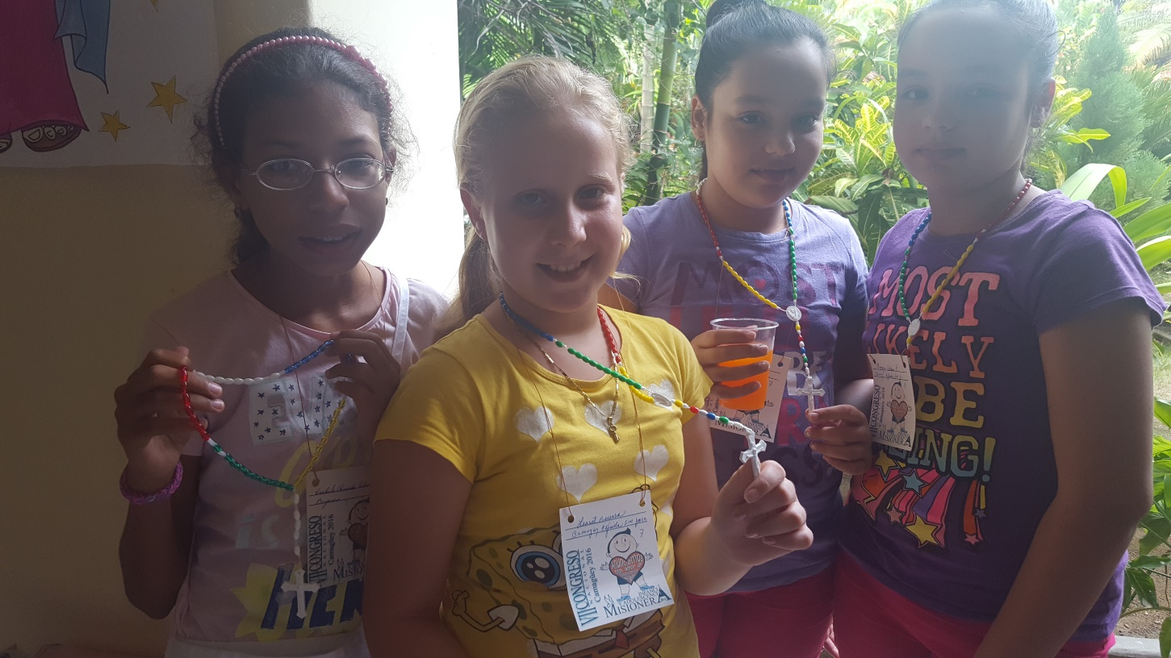
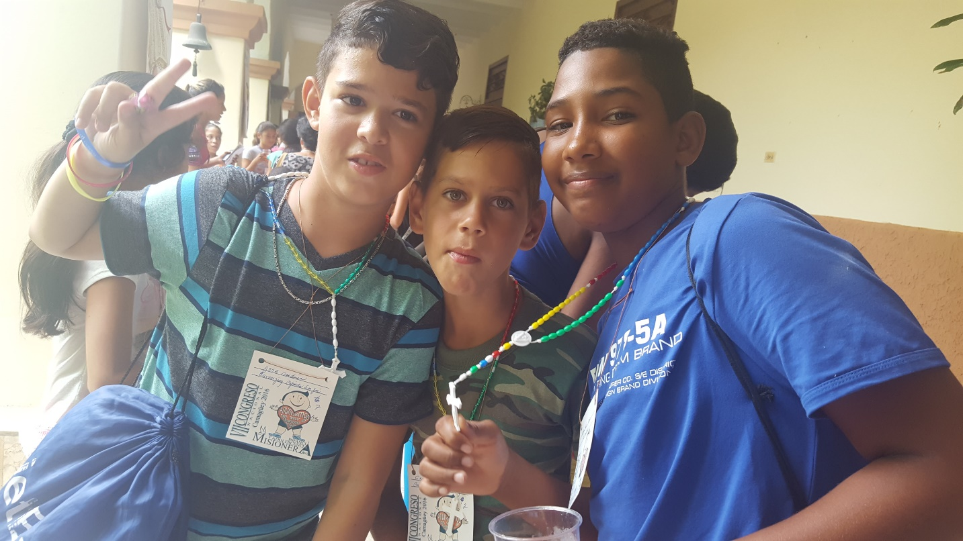
When Marilyn Santos, Director of Mission Education for the Pontifical Mission Societies in the United States (below left), attended the August 2016 MCA Congress in Cuba, she brought some World Mission Rosaries made by Missionary Children in the Archdiocese of Philadelphia!

Slide 18
Missionary Childhood Association
Archdiocese of Philadelphia
222 N. 17th Street, Philadelphia, PA 19103
www.phillymissions.org
MCA@archphila.org
215-587-3945

